Slide 1
Data Mining
MSCI:6070
L12 Data Mining Project Guidelines
Instructor: Tong Wang (tong-wang@uiowa.edu)

Slide 2

Things you should cover
Business Goal
Data Mining Goal
Dataset description
Exploratory analysis
Methods
Evaluation and results discussion
Conclusions/Insights/recommendations
Next step
Notes:
http://www.galitshmueli.com/student-projects?page=1

Slide 3
Examples of Previous Projects
Medical Appointment No-Shows Prediction
Predict which appointment will have a no-show, given the patient information, reason for appointment, date, etc
Customer Churn Prediction for Telco
Predict if a customer will cancer its service at Telco, which is a telephone and internet provider
Direct Mail Marketing
Predict which customers will buy a product from an insurance company

Slide 4
Project Content
Business Goal
Background
Why is this problem important?
Who would care about this? who can be the potential clients for this product?
What’s the current status in this field?
What do you want to do?
Data Mining Goal
Supervised learning?
What type of problem? (classification? Regressoin? Clustering?)
What is the target variable?
Examples
Medical Appointment No-Shows Prediction
Customer Churn Prediction for Telco
Direct Mail Marketing
Notes:
http://www.galitshmueli.com/student-projects?page=1

Slide 5
Project Description
Dataset description
How many instances in the dataset?
How many categorical features? How many numeric features?
Data Preparation
How do you deal with missing value?
Do you plan to use all features?
Do you need to develop the target variable from the dataset? How?
Is it necessary to do feature selection? Be aware of data leakage problem
Exploratory analysis
Plots, clustering ,etc
The goal of this part is to provide initial understanding of the problem and the dataset, identify important features and draw simple conclusions
Notes:
http://www.galitshmueli.com/student-projects?page=1

Slide 6
Project Content
Methods
Try all possible methods
Classifier: SVM, Logistic Regression, decision trees, ANN, ensemble (random forest, adaboost, gradient boost)
Regressor: linear regression, decision trees, ensemble
Tune parameters for each method to obtain the best model and then choose from the best models
Evaluation
What metric is suitable for this task?
Classification: ROC, accuracy, precision, recall, cost curve, or others?
Regression: MSE, MAE, R-square?
Make sure you discuss your result: What do you observe from the table/figure/result. What conclusions can you make?
When choosing the evaluation metric, link it to the business problem and think about the business content
Notes:
http://www.galitshmueli.com/student-projects?page=1

Slide 7
Project Content
Conclusions/Insights/recommendations
How does your model meet the business goal
Any insights or conclusions? Any insights or conclusions should be supported by discoveries from previous modeling and evaluation part. Do not make conclusions that are not supported by the data!
By completing the project, you should know about this problem than other people in the room. So present like an expert.
Next step
How to use the model?
How to improve the model?
More data? Plot the learning curve
Notes:
http://www.galitshmueli.com/student-projects?page=1

Slide 8
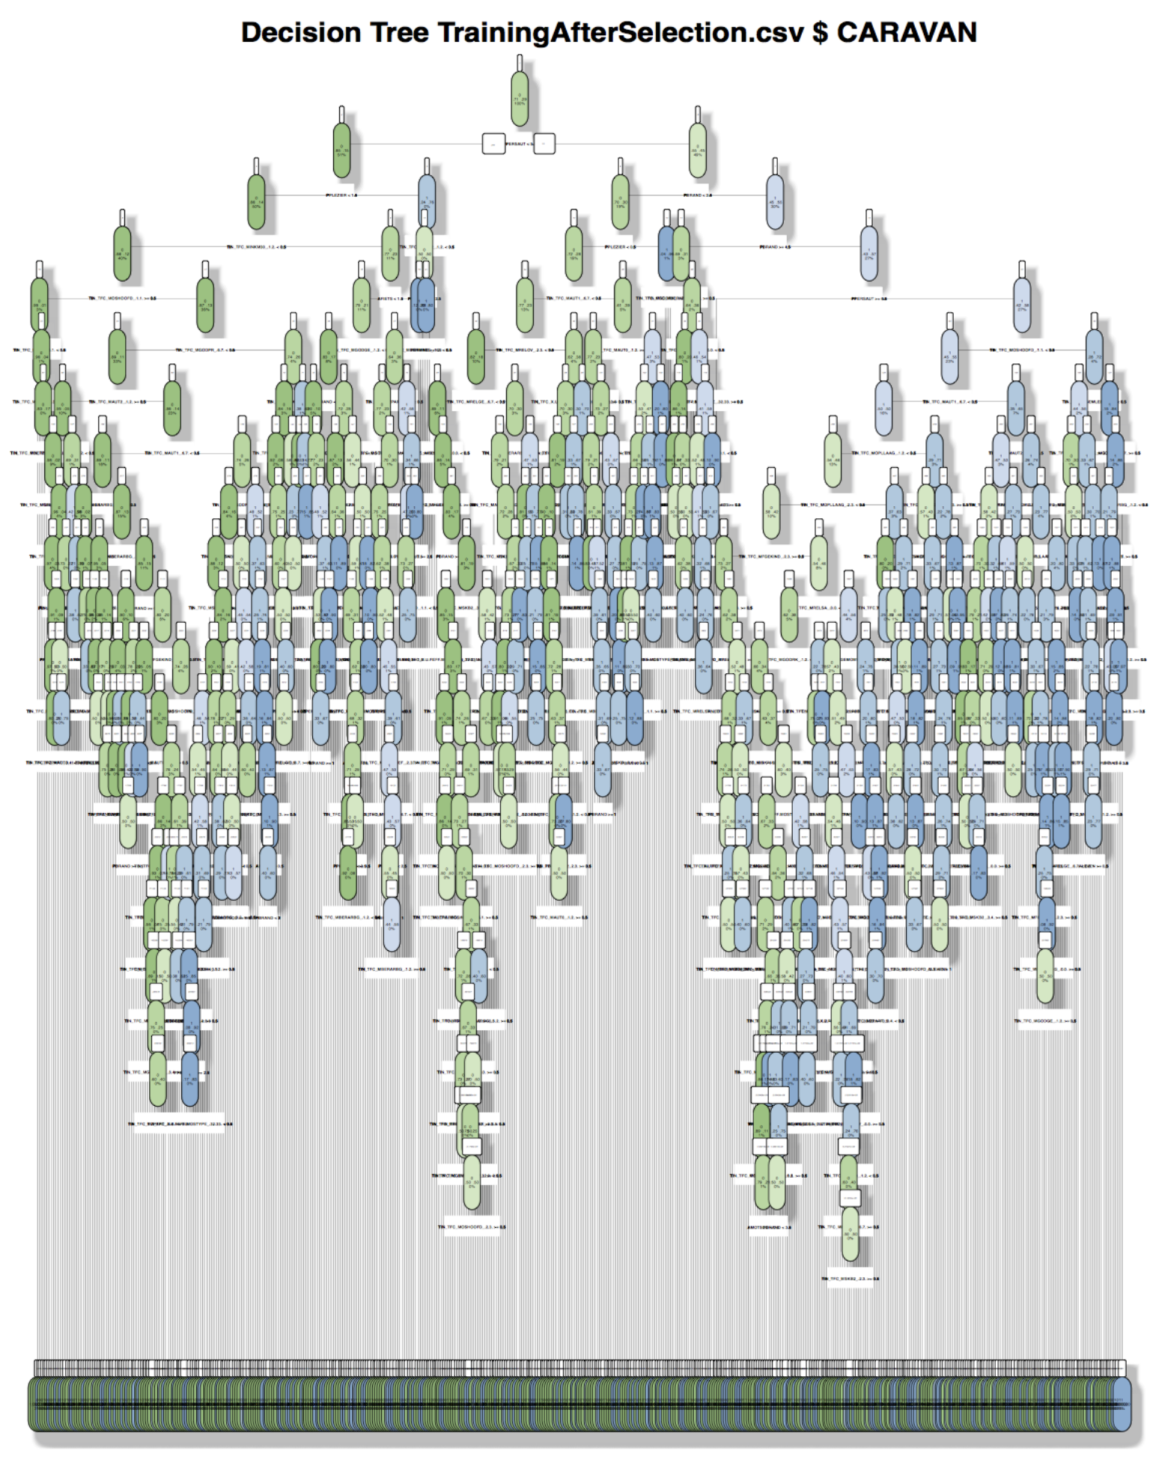
Things That Do Not Go Into the Report
Code
You can put it in the appendix
Screenshots of implementation details in Rattle
I do not need to know the implementation detail. Just describe the main steps with words and summarize results in tables, Figures, or texts.
Results that are not readable

Slide 9
Tips for Giving a Presentation
Only show the most interesting results
Reduce text
Try to show your idea using figures, diagrams and tables.
Think about the average time you spend on each slide
Make sure every word is readable, including words and labels in a figure
Skip implementation details
Use your time wisely on the most important and interesting things
Your presentation is NOT a document for everything you have done
Do not read off a note
Rehearse!

Slide 10
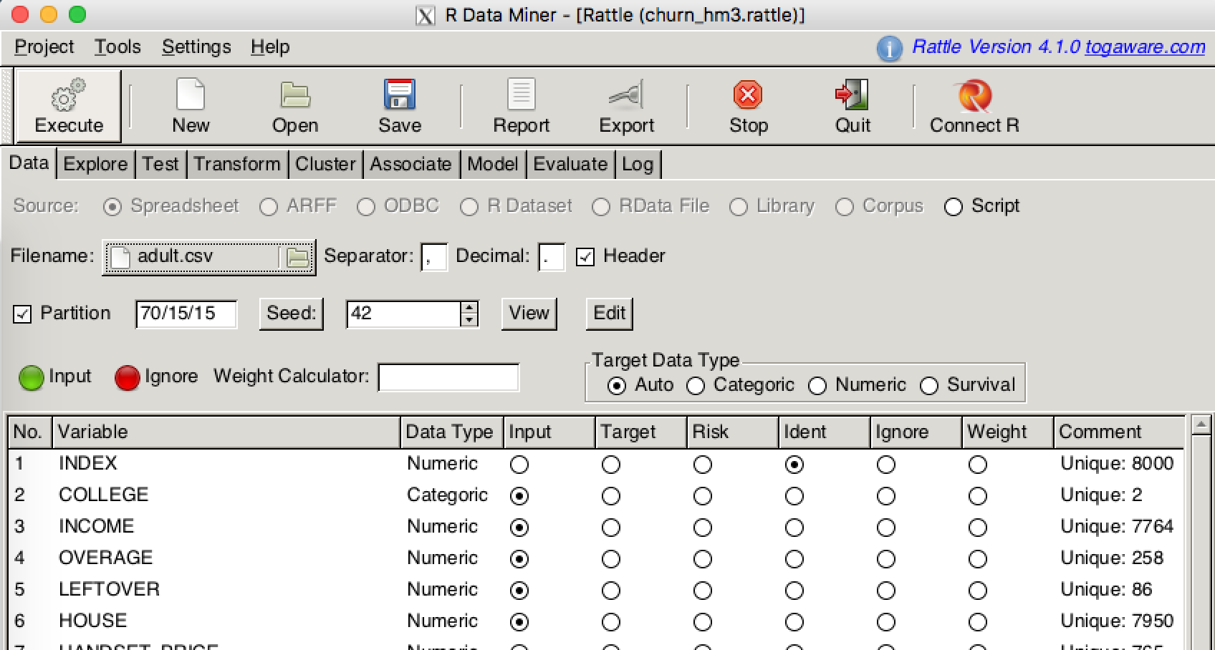
Tips for Implementation
Save the processed data so you can share with the team
It is very important to correctly preprocess the data!
Make sure you understand the type of features

Slide 11
Datasets
Sources for datasets
https://data.world/
https://archive.ics.uci.edu/ml/datasets.html
https://www.kaggle.com/datasets
https://www.quandl.com/search
or others you can find
Minimum requirement for size data
At least 10 features and 1000 instances

Slide 12
Useful resources
http://www.galitshmueli.com/student-projects?page=1
R codes for additional processing on ICON
Some basic processing in R
Merge two datasets
See merge_2df.R
Extract words from text
Create additional features
See extract_word.R
Feature selection
See feature_selection.R

